Slide 1

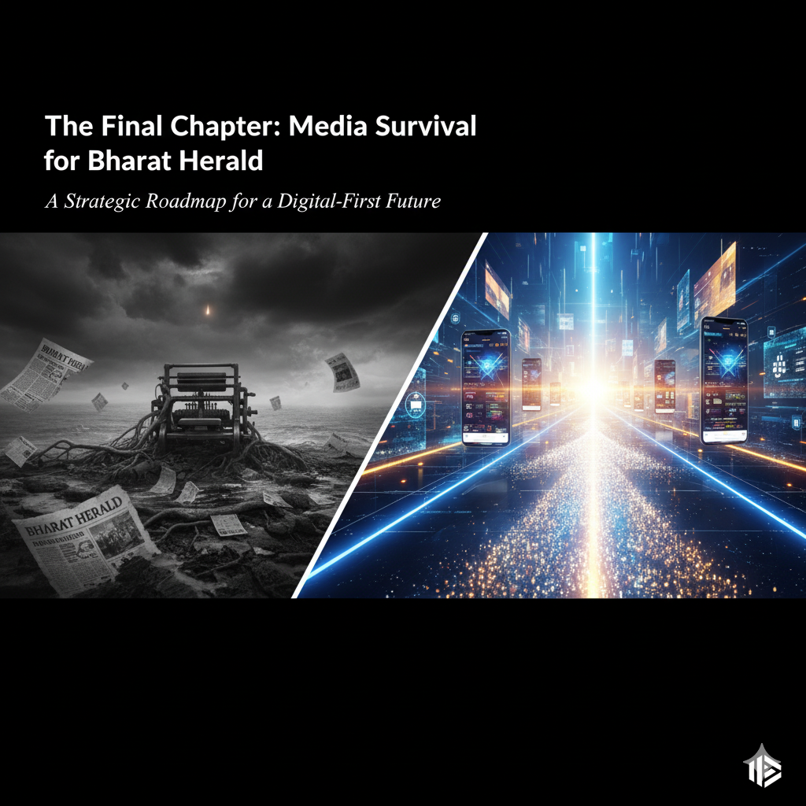
The Final Chapter: Media Survival for Bharat Herald A Strategic Roadmap for a Digital-First Future
Aishwarya Prabhakaran
[25-09-2025]

Slide 2
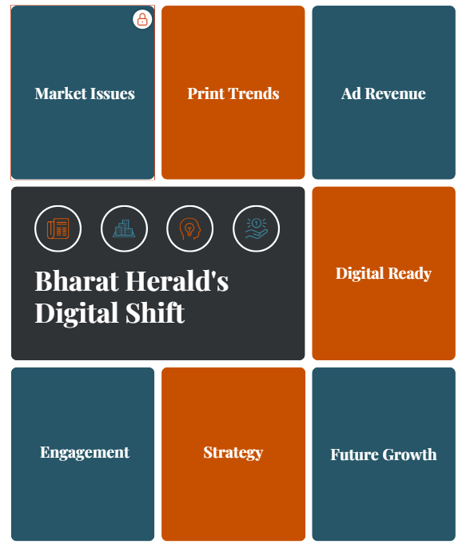
Executive Summary
Bharat Herald faces a challenging but opportunity-filled landscape.
Print circulation and revenues have stagnated or declined in several key cities, while ad revenue remains highly concentrated in a narrow set of categories.
Digital readiness across cities is high, confirming strong potential for digital content, monetization, and new services.
However, the true challenge lies in converting this readiness into sustainable engagement and revenues.
Bharat Herald now stands at a crossroads : It has the data, operational control, and digital foothold to engineer a full transformation, but must accelerate its digital programs through best strategies and capitalize on this potential

Slide 3

Introduction
Why This Analysis Was Undertaken ?
Understand current print and digital revenue and circulation trends across key cities.
Identify geographic and category-based risks that threaten sustainable growth.
Discover gaps between digital readiness and actual engagement to inform digital transformation strategy.
Pinpoint growth opportunities in emerging digital markets and advertising sectors.
Establish a reliable data foundation and measurement approach to support evidence-based decision-making.
Goal : To Equip Bharat Herald leadership with actionable insights to stabilize print operations, optimize ad revenues, and establish digital monetization and audience engagement—ensuring long-term business resilience.

Slide 4
Methodology
Data Source
Data Source:
Provided By Codebasics - Check here
Data Cleaning & Preparation
Removed inconsistencies in quarter and month columns, standardizing formats for reliable temporal analysis.
Harmonized city and state names with consistent casing and spelling to ensure accurate joins.
Data Exploration & Structuring
Explored data visually and statistically using Power query and MySQL workspace.
Data Visualization Approach
Leveraged bar charts to track high-level volume and revenue trends by city and year.
Used scatter plots and line charts to highlight growth potential and conversion efficiencies.
Insight Extraction
Focused on:
Ad categories contributing most to revenue for diversification.
Yearly and city-wise print circulation decline patterns for risk mitigation.
Cities with digital readiness but low pilot engagement to prioritize digital activation.
Data Preparation
Data Exploration
Data Visualization
Insight Extraction
Strategy/Actions

Slide 5
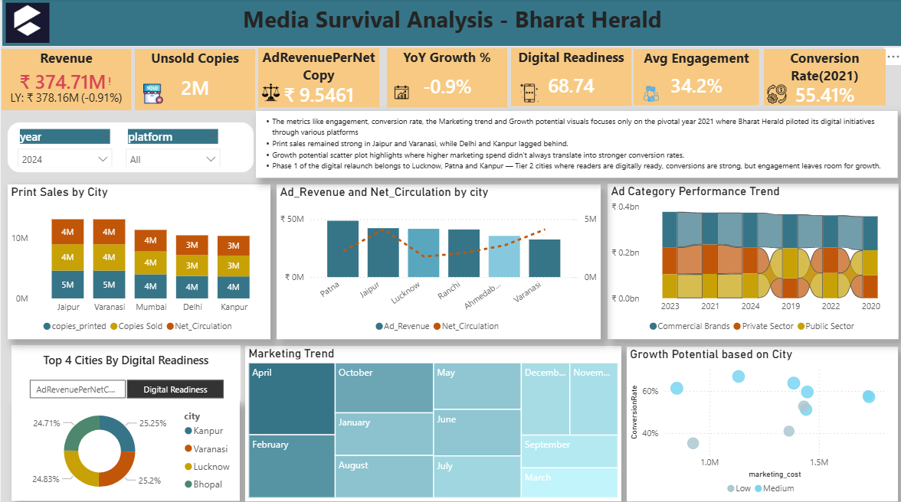
Click here to download dashboard

Slide 6
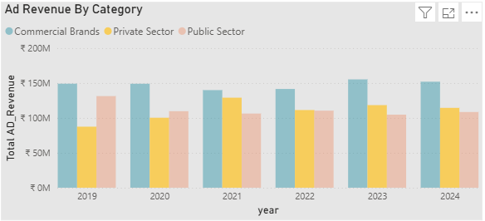
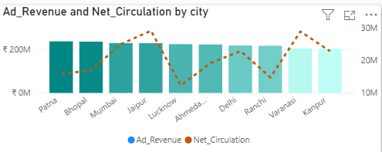
Key Insights -Based On Ad revenue
Commercial Brands remain the anchor; growth depends on re‑accelerating Private Sector or reversing Public Sector decline.
2021 was an unusual year for Private Sector ad revenue, and it didn't represent a sustainable trend and spike is possibly caused by
One-off campaigns: Specific, short-term advertising pushes from private companies (or)
Macro effects: Broader economic trends that briefly boosted private sector ad spending.
Cities with higher circulation generally show higher ad revenue, implying circulation is a driver but not the only one.⁠⁠​
Patna: Top ad revenue with medium circulation. Strong monetization efficiency baseline.
Jaipur and Lucknow: Similar revenue bands, but Jaipur’s higher circulation with only slightly higher revenue suggests Lucknow looks more efficient than Jaipur.
Ahmedabad: A dip in both circulation and revenue. Potential underperformance to investigate
Varanasi: Circulation climbs while revenue lags the leaders, pointing to untapped ad potential

Slide 7
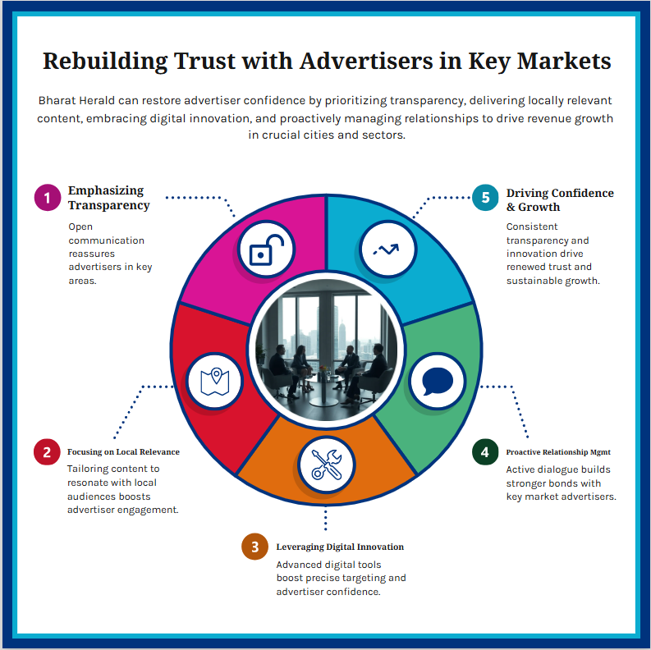
Strategic Recommendations - Ad Revenue
Strengthen Commercial Brand Partnerships by expanding strategic alliances with top commercial advertisers
Treat the unusual spike in private sector ad revenue as a signal for agile campaign design and monitor for sustainable segment opportunities
Diversify and Innovate: Counter concentration risk by developing new ad products and incentives for government and public services.
Replicate Patna’s strong monetization tactics in other mid-circulation cities; deploy pilot programs for cities with lagging performance like Ahmedabad and Varanasi.
Regularly assess city-level circulation and ad trends to identify pockets of underperformance or hidden growth.
Deploy custom strategies—marketing programs, community engagement, or premium ad targeting—fitting each city’s unique audience and advertiser mix.

Slide 8
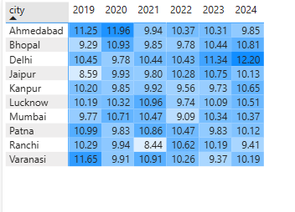
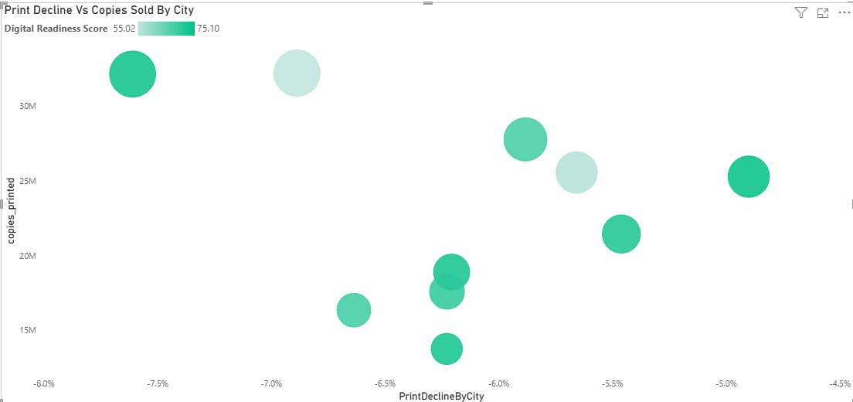
Key Insights -Based On Print Sales across Cities
Broad trend: Modest recovery post‑2020 dip, with most cities regaining or slightly exceeding 2019 levels by 2022–2024. No explosive growth, but steady normalization.
Kanpur, Patna, Lucknow → Circulation gap stays in ~9–10%, showing better control and efficient demand-supply match
Delhi and Ahmedabad shows fluctuating but high gaps, indicating inconsistent distribution.
Circulation gap %
The total print circulation has declined by −6.17% across all listed cities.
The Kanpur Anomaly: Kanpur has high Digital Readiness Score but exhibits the lowest print decline.
This is a significant outlier and suggests that it's possible to have a digitally savvy population that still engages with print media.
Jaipur and Varanasi: Despite their market dominance, they are among the cities with the steepest declines .
There are factors other than just digital news adoption are causing people to move away from print in these cities.

Slide 9
Strategic Recommendations - Print Sales
Focused Demand-Supply Optimization by implementing continuous demand forecasting and distribution adjustments in all cities to minimize unsold copies.
Deploy root cause analysis teams for cities like Delhi and Ahmedabad to pinpoint logistical or market issues causing fluctuations.
In Jaipur and Varanasi, Launch market-specific campaigns to understand and counter local drivers of print attrition.
Move away from one-size-fits-all strategies: use city segmentation to tailor product, pricing, and ad solutions.
In Kanpur, Pilot hybrid content and bundled subscription campaigns to convert digital-ready readers while maintaining strong print engagement.
Redirect saved resources to digital product and analytics investment for faster digital transition.

Slide 10
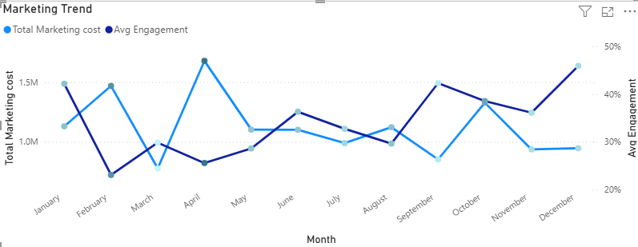
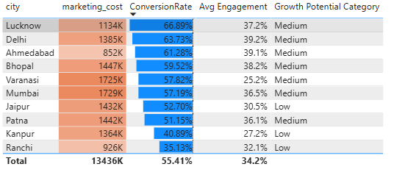
Key Insights –Digital Pilot - 2021
The "More Money, More Problems" :
High Spending Leads to Poor Results
Worst Performing Month: April was the most expensive month resulting in second-lowest Conversion Rate
This pattern strongly suggests that when the budget increases, the marketing efforts are likely targeting a broader, less-qualified audience.
Lucknow is the best-performing with High efficiency — best ROI city.
Delhi & Ahmedabad Are Strong Contenders - Both are cost-effective growth markets.
Varanasi and Kanpur = Weak Growth : Suggests money is being spent, but customers are not actively interacting
Jaipur, Kanpur, Ranchi are categorized as Low Growth Potential areas, and they also show below-average engagement and conversion rates.

Slide 11
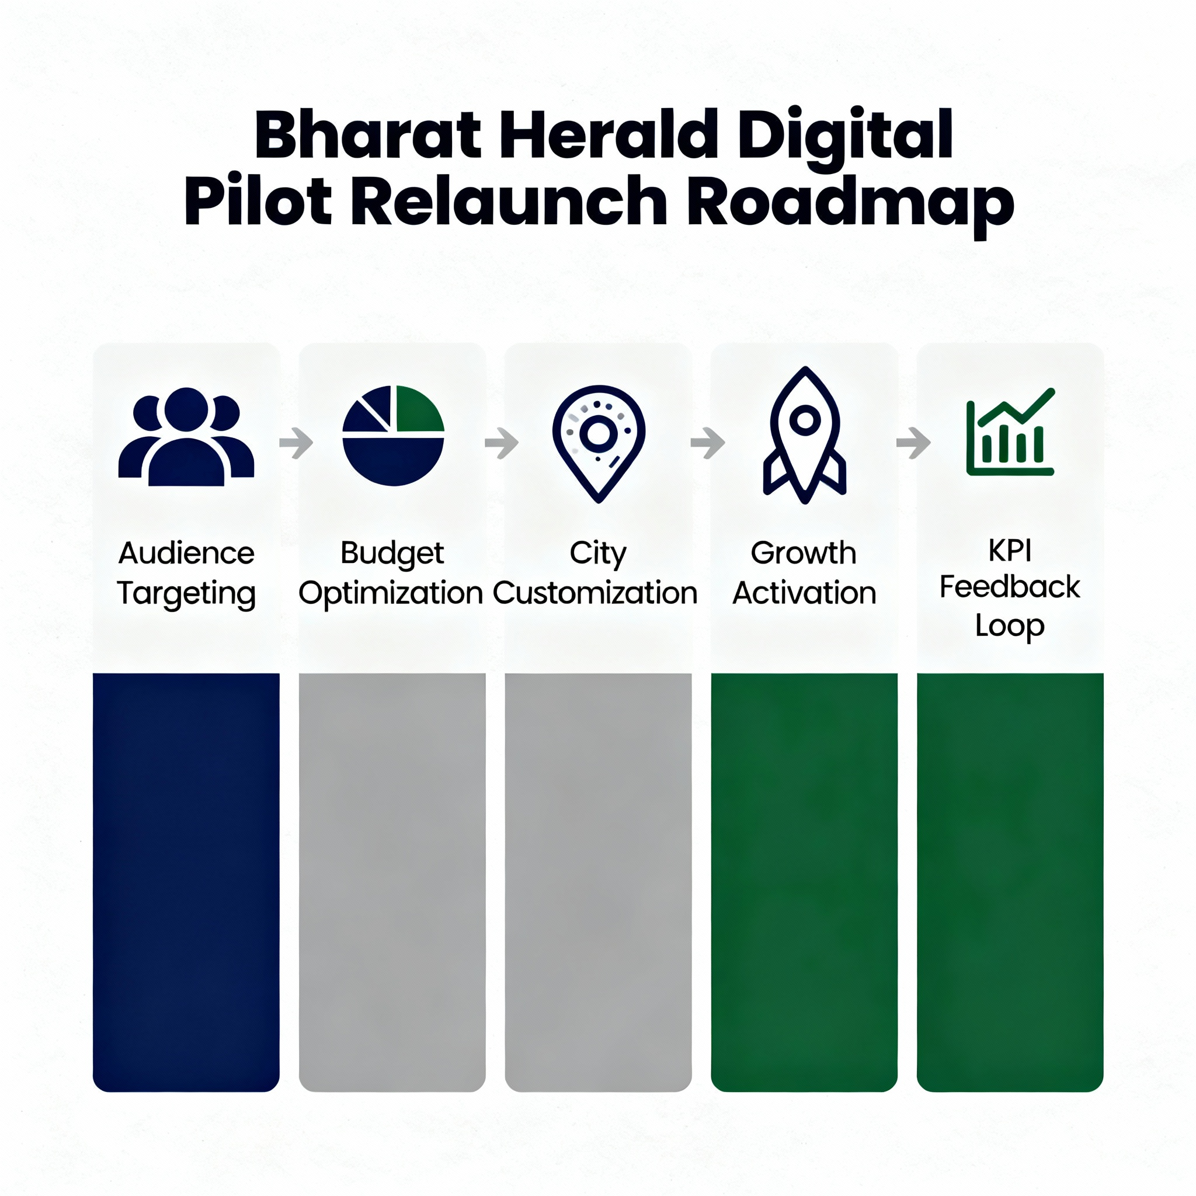
Strategic Actions - Digital Pilot
Sharpen Audience Targeting : Use audience segmentation and behavioral data to focus marketing spend on high-likelihood subscribers rather than broad, less-qualified audiences.
Budget Allocation Optimization : Shift spend away from low ROI periods and markets; prioritize cities like Lucknow and Delhi with proven higher ROI and engagement.
Establish Feedback Loop and Continuous Learning : After each campaign wave, survey users and analyze digital interaction data to adapt offers and formats.
Transparent and Actionable Metrics : Set specific YOY or monthly digital KPIs for all pilot cities— Share insights regularly with teams to maintain focus and collaboration toward pilot success.
For best performers like Lucknow, create reference case studies and replicate strategies in similar markets.
In low growth potential cities (Jaipur, Kanpur, Ranchi), run digital literacy workshops and bundled subscription offers to drive up engagement and conversions.

Slide 12
AdHoc Request – Findings & Implications
Business Request | Key Findings | Implications
1. Circulation Decline Hotspots | Varanasi saw a significant drop in net circulation from 431,606 (Nov 2019) to 382,018 (Jan 2021); | Focus marketing, retention, and print cost control in declining cities to prevent revenue loss.
2. Revenue Concentration by Ad Category | Commercial brands dominate ad revenue; private and public sectors fluctuate, with 2021 as an unusual spike year. | Diversify advertiser base and tailor short-term campaigns to capture emerging private sector opportunities.
3. Print Efficiency Variation | With Ranchi at the top, all other cities in top 5 have print efficiency near 90 %. | Create reference case studies and replicate strategies in similar markets
4. Internet Penetration Growth (Digital Readiness) | Kanpur shows the highest internet growth from Q1-2024 to Q4-2024. Followed By Mumbai, Delhi, Ahmedabad and Patna as the top 5 cities with internet growth | Target digital product launches, campaigns, and monetization efforts in digitally ready, high growth cities.
5. Circulation & Ad Revenue Multi-Year Decline | Most cities show print circulation declines more consistently than ad revenue declines. Declines are not always continuous; some cities show intermittent recovery years. | This underlines the urgent need for integrated market interventions combining print optimization and digital/advertising innovation specific to each city’s market dynamics.
6. Digital Pilot Engagement & Readiness Gap (2021) | Kanpur has the highest digital readiness score but among the bottom 3 in digital pilot engagement. | Loyalty schemes gather consumer data that enable targeted offers, personalized recommendations, and better ad targeting.

Slide 13
Phases of Digital Transition
Focus digital pilot program on cities with top readiness but bottom engagement (e.g., Kanpur) to understand barriers.
Avoid broad, unqualified audiences; use data-driven segmentations to target engaged subgroups effectively
Introduce value subscription bundles integrating print and digital products to enhance customer retention.
Launch interactive features (e.g., personalized news, quizzes) to raise engagement in cities with readiness but low digital activity.
Introduce loyalty programs, pay-per-article, and micro-subscriptions to diversify income and appeal to diverse digital consumers.
Leverage engagement data to offer targeted digital advertising solutions to broader categories beyond commercial brands.
Implement AI to customize news feeds, ads, and subscription offers dynamically.
Fully integrate print and digital consumer data to create seamless multi-channel customer journeys and insights.
Foundation & Pilot Expansion
(0–3 months)
Localized Growth & Monetization
(3–9 months)
Digital Product Scaling (9–18 months)
Advanced Analytics & Continuous Improvement
(18+ months)

Slide 14
Content Format & Delivery Enhancements to Boost Digital Engagement
Digital Strategy | Primary Goal | Key Implementation Detail
WhatsApp Bulletins | Deliver bite-sized, timely news updates, leveraging a popular and highly accessible platform. | Use conversational tones and multimedia (images, voice notes) for maximum engagement.
Mobile-Optimized E-Papers | Ensure quick load times and easy navigation for the mobile-first audience. | Design e-papers specifically for mobile screens; incorporate interactive elements like clickable headlines, embedded videos, and shareable snippets.
Personalized Newsletters | Curate content based on reader preferences and behaviors. | Use AI to adjust topic focus and format per subscriber engagement patterns, sending personalized daily/weekly emails or app notifications.
Multimedia Content | Appeal to diverse consumption styles beyond just text. | Integrate multimedia such as videos, podcasts, and infographics; leverage short-form videos optimized for social media channels.
Push Notifications & Alerts | Increase active return visits and retain user attention. | Implement accurate targeting for breaking news, personalized stories, or promotional ad offers.
Social Media Integration | Enable easy sharing, comments, and discussions around content. | Seamlessly connect digital content with all major social media platforms.
Micro-Content & Interactive Features | Engage readers beyond passive consumption and provide utility during short breaks. | Offer interactive quizzes, polls, or local community events coverage; provide short summaries or bulletins for quick reads.
Subscription & Paywall Flexibility | Lower barriers for digital adoption and convert more casual readers into paying subscribers. | Offer trial periods, freemium models, and pay-per-article options.

Slide 15
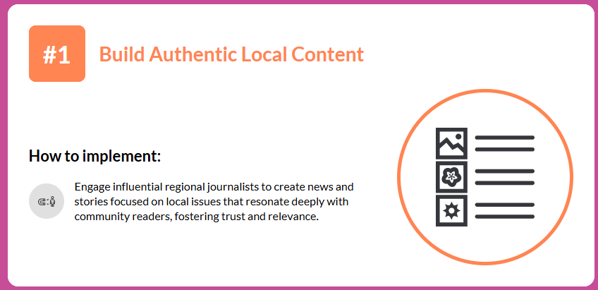
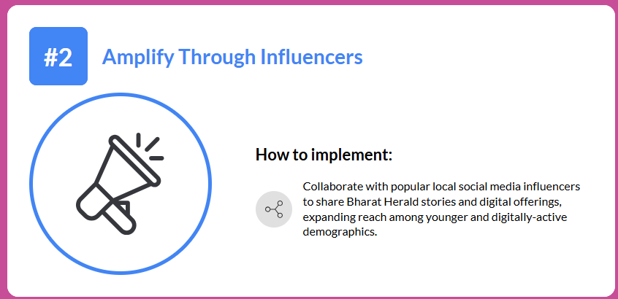
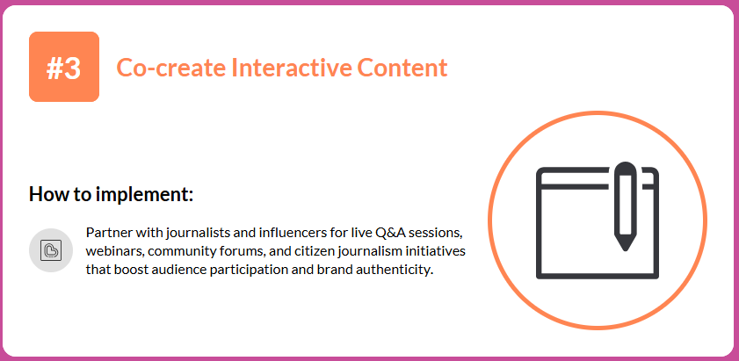
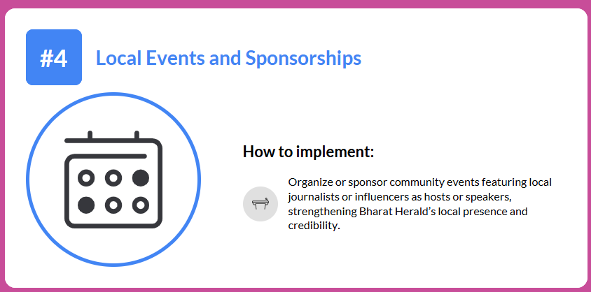
Re-Establishing Digital Credibility

Slide 16
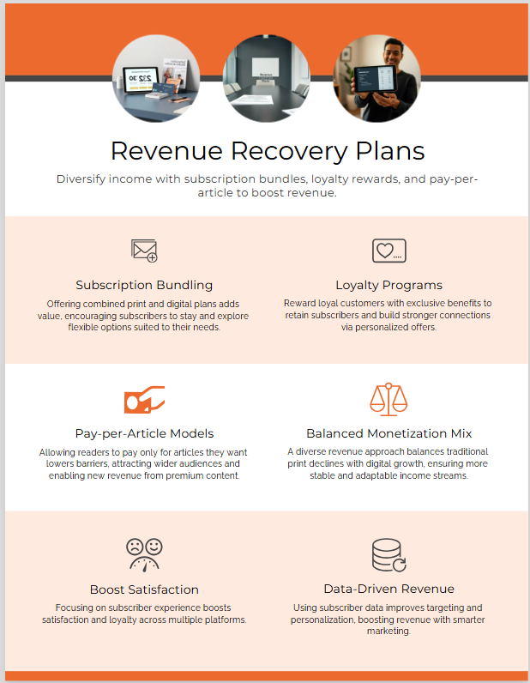
Revenue Recovery Plans
Subscription Bundling
"One package, multiple platforms — more value, more loyal subscribers.“
Loyalty Programs
"Rewarding engagement, boosting retention.“
Pay-Per-Article Models
"Flexibility for today’s reader, revenue for tomorrow’s growth."

